Slide 1

Advanced Digital Clock and Data Recovery (CDR) Project
Advanced VLSI Design
Gavin Garrison
1
04/14/2025

Slide 2
Project Overview
Designed a digital Clock and Data Recovery (CDR) circuit for high-speed serial links.
Applied advanced DSP techniques (adaptive filtering) to reduce jitter and phase error.Implemented in Verilog, simulated in Vivado.
Performance and power results compared between baseline (static) and adaptive versions (Reinforcement Learning-based).
2
04/14/2025
Notes:
Goal: The project is centered around the design of a Clock and Data Recovery (CDR) circuit that is crucial for high-speed serial data transmission. We aim to reduce jitter and phase error to ensure data integrity and signal accuracy.
Implementation: The design was implemented in Verilog and tested with Vivado simulation. Performance comparisons between the baseline design (using a basic GPD) and the adaptive design (using reinforcement learning for dynamic control) are made to evaluate the improvements in phase error reduction and overall performance.

Slide 3
Objective & Scope
Improve phase-lock accuracy under jitter and noise.
Explore reinforcement learning-based adaptive filtering to optimize phase error.
Maintain timing correctness and low power consumption.
Deliver RTL modules, testbenches, performance analysis, and diagrams.
Demonstrate scalable and hardware-efficient CDR architecture.
3
04/14/2025
Notes:
Key Objectives:
The main goal was to improve the phase-lock accuracy in the presence of jitter and noise. This ensures that the recovered clock is as close as possible to the ideal clock, minimizing errors during the recovery process.
I explored different methods, including Kalman filtering, PI control, and reinforcement learning (RL), to adaptively adjust the gain in the loop filter.
Scope:
While jitter is a significant concern in CDR systems, our scope was to use adaptive methods, like the RL-based filter, to improve the clock recovery accuracy over traditional methods.
The project ensures that the system maintains timing correctness and does so while being power efficient, an important consideration for high-speed communication systems.

Slide 4
System Architecture
Granular Phase Detector (GPD): A more precise detector that measures phase error in finer steps
Loop Filter: Adaptive control based on phase error using reinforcement learning.
Numerically Controlled Oscillator (NCO): Drives the recovered clock based on control input.
Feedback Loop: Forms a digital PLL (Phase-Locked Loop).
4
04/14/2025
Notes:
Granular Phase Detector (GPD): The GPD is a key innovation in this project. It measures phase errors in a more granular way compared to traditional Bang-Bang detectors. Instead of just signaling “early” or “late,” the GPD outputs phase error in finer steps. For example, it can output values from -8 to +7, which provides more information about how far the recovered clock is from the ideal clock.
Loop Filter: The loop filter is the heart of the adaptive control mechanism. In the baseline design, it simply integrates the phase error to adjust the clock recovery rate. In the adaptive design, a reinforcement learning (RL) agent learns from the phase error trends and adjusts the gain dynamically, improving the clock's ability to lock under varying jitter conditions.
NCO (Numerically Controlled Oscillator): This component receives the control word from the loop filter and generates the recovered clock. The NCO is controlled by a frequency word, which determines its output frequency. PPL: Synchronizes the two signals ensures the outputs phase tracks the inputs phase
Modular Design: The architecture is modular, allowing easy replacement or modification of components (e.g., using Kalman filters or other control strategies in place of the RL agent).
module rl_agent_ml(
input clk,
input reset,
input signed [7:0] phase_error, // e.g., a granular error, now possibly in a wider range
input signed [7:0] jitter, // A small value representing jitter
output reg signed [15:0] gain_adjustment,
output reg signed [7:0] w1_out,
output reg signed [7:0] w2_out,
output reg signed [7:0] bias_out
);
// Internal weight registers
reg signed [7:0] w1, w2, bias;
// Learning parameters
parameter signed [7:0] LEARNING_RATE = 8'sd8; // More aggressive learning
parameter integer SHIFT_FACTOR = 2; // Damping: divides update by 4
parameter integer WINDOW_SIZE = 100; // Batch update window
// Weight clamping limits
parameter signed [7:0] WEIGHT_MIN = -64;
parameter signed [7:0] WEIGHT_MAX = 64;
// Accumulators for batch update
reg [6:0] cycle_count; // Enough to count up to WINDOW_SIZE (here, 100)
reg signed [15:0] accum_error;
reg signed [15:0] accum_jitter;
// We'll declare these at module level (for use in batch update)
reg signed [15:0] total_error;
reg signed [15:0] reward;
// Refined reward: Quadratic scaling of error.
// For example, reward = -((|total_error|^2)/REWARD_DIVISOR)
parameter integer REWARD_DIVISOR = 4;
// Continuous computation of gain_adjustment for driving downstream blocks
always @(*) begin
gain_adjustment = (phase_error * w1) + (jitter * w2) + bias;
end
// Batch update: Accumulate error over WINDOW_SIZE cycles then update weights
always @(posedge clk or posedge reset) begin
if (reset) begin
w1 <= 8'sd2;
w2 <= 8'sd1;
bias <= 8'sd0;
cycle_count <= 0;
accum_error <= 0;
accum_jitter <= 0;
end else begin
accum_error <= accum_error + phase_error;
accum_jitter <= accum_jitter + jitter;
cycle_count <= cycle_count + 1;
if (cycle_count == (WINDOW_SIZE - 1)) begin
total_error = accum_error; // total error over the batch
// Compute a quadratic reward.
// This reward will be negative and larger for higher absolute total_error.
if (total_error < 0)
reward = -(((-total_error) * (-total_error)) / REWARD_DIVISOR);
else
reward = -((total_error * total_error) / REWARD_DIVISOR);
// Update weights using the batch accumulated error and reward.
w1 <= clamp( w1 + ((LEARNING_RATE * reward * accum_error) >>> SHIFT_FACTOR) );
w2 <= clamp( w2 + ((LEARNING_RATE * reward * accum_jitter) >>> SHIFT_FACTOR) );
bias <= clamp( bias + ((LEARNING_RATE * reward) >>> SHIFT_FACTOR) );
// Reset accumulators and cycle count for next batch
accum_error <= 0;
accum_jitter <= 0;
cycle_count <= 0;
end
end
end
// Clamping function to restrict weights to [WEIGHT_MIN, WEIGHT_MAX]
function signed [7:0] clamp;
input signed [15:0] val;
begin
if (val > WEIGHT_MAX)
clamp = WEIGHT_MAX;
else if (val < WEIGHT_MIN)
clamp = WEIGHT_MIN;
else
clamp = val[7:0];
end
endfunction
// Expose internal weights for debugging
always @(*) begin
w1_out = w1;
w2_out = w2;
bias_out = bias;
end
endmodule

Slide 5
Feature | Bang-Bang Phase Detector (BBPD) | Granular Phase Detector (GPD)
Output Precision | Binary (2 states: Early/Late) | 4-bit (16 states: -8 to +7)
Resolution | Low (coarse control) | High (fine-grained control)
Phase Error Range | ±1 (only early/late) | ±8 (detailed phase offset)
System Feedback | Coarse adjustment (clock direction) | Fine adjustment (dynamic frequency)
Adaptability to Noise | Less adaptable | More adaptable to jitter/noise
Complexity | Simple, low resource usage | Slightly higher logic, more precision
5
04/14/2025
Notes:
In this slide, we will compare two phase detection methods: the Granular Phase Detector (GPD) and the Bang-Bang Phase Detector (BBPD). Both are crucial for clock data recovery (CDR) systems, but they differ significantly in terms of precision, complexity, and performance.
We'll focus on their structure, the number of bits used in each, and how these factors influence the phase error detection and overall performance in the context of a CDR system.
Granular Phase Detector (GPD):
Precision & Phase Resolution:
The GPD in this design uses 4 bits for the phase error output. This translates to 16 distinct error levels, ranging from -8 to +7, which allows for more precise phase error measurement compared to the BBPD.
The 4-bit resolution enables finer-grained control over the phase error, allowing for smoother feedback and better phase correction.
Operation:
GPD works by detecting the phase difference between the data input (d_in) and the recovered clock (recovered_clk). The phase difference is detected at a much higher resolution compared to the binary high/low outputs of a BBPD. Edge detection is done using a combination of clock cycles and a shift register to capture the precise timing of the rising edges of both signals.
More granular error detection helps the system make adjustments in finer steps, improving the overall phase lock and reducing jitter.
How it Compares:
The GPD doesn't just tell us whether the recovered clock is early or late; it tells us how early or late it is, allowing for a more adaptive response from the system. This results in more accurate phase correction over time.
GPD allows for more nuanced feedback, which contributes to more efficient loop filter behavior. In turn, this can result in faster convergence and improved overall stability of the recovered clock.
Bang-Bang Phase Detector (BBPD):
Precision & Phase Resolution:
The BBPD is a simpler phase detector, typically outputting binary values to indicate whether the phase of the recovered clock is ahead or behind the data signal. It's typically a 1-bit error detection scheme that only detects early or late, rather than providing the actual degree of phase error.
This binary nature is sufficient for many simple applications but lacks the ability to resolve the error with finer granularity. It gives a basic high/low output based on whether the recovered clock signal is leading or lagging the data signal.
Operation:
The BBPD compares the edges of the data signal and the recovered clock. It outputs a binary signal based on whether the data signal is ahead of or behind the recovered clock. If the data signal is earlier than the clock, the output is high; if it's later, the output is low.
The phase error is binary, meaning the phase detector outputs a simple decision to indicate whether the system needs to advance or delay the clock. This lack of precision can result in slower convergence and a less stable system when jitter or noise is present.
How it Compares:
Since it lacks any notion of intermediate phase errors, the BBPD typically produces less accurate corrections in environments with jitter. The binary nature of the output makes it harder to adapt quickly to smaller variations in phase, meaning it often requires a more conservative approach in its feedback loop.
The BBPD system tends to be more resource-efficient because of its simplicity (i.e., it requires fewer bits and simpler logic). However, this efficiency comes at the cost of less precise phase correction.
Bits for Phase Error: The key difference in precision comes from the number of bits used for error detection. The GPD uses 4 bits, meaning it can detect 16 distinct phase error levels, which gives it much better precision and finer control. On the other hand, the BBPD uses just 1 bit, giving it only a binary distinction (early or late), which is less precise.
Error Detection Precision: The granular detector is able to detect small differences in phase error, which allows for more accurate adjustments in the control loop. The BBPD, however, only detects whether the phase is early or late, which can lead to overshooting or insufficient corrections, especially when phase shifts are small.
Phase Error Range: The GPD's error range spans from -8 to +7 due to its 4-bit representation, while the BBPD only reports two states: early or late, with a phase error range limited to -1 to +1. This means the GPD provides more detailed information, leading to smoother adjustments over time.
Adaptive Feedback: Because the GPD provides detailed phase error data, it can adapt to the system's performance much more effectively. It makes smaller, more precise corrections, allowing for faster convergence. The BBPD, by only knowing if the clock is early or late, can struggle to find the optimal phase correction, especially under noisy or jittery conditions.
Complexity and Resource Requirements: The GPD is more complex, requiring more logic for handling the higher bit-width phase error and the finer granularity of feedback. However, the BBPD is simpler, using minimal logic to just determine if the clock is early or late, making it resource-efficient but at the cost of performance.
Performance in Jitter: The GPD performs better in jittery environments because it can detect small variations in phase, which results in smoother and faster adjustments. The BBPD, however, is less effective under jitter because it only reacts to binary early/late signals, which can result in slower or more erratic behavior when the phase error fluctuates.
System Convergence: The GPD system converges faster because it makes finer adjustments to phase error. The BBPD, while simpler and faster in response time, can suffer from slower convergence due to its lack of precision and fine-grained feedback.

Slide 6
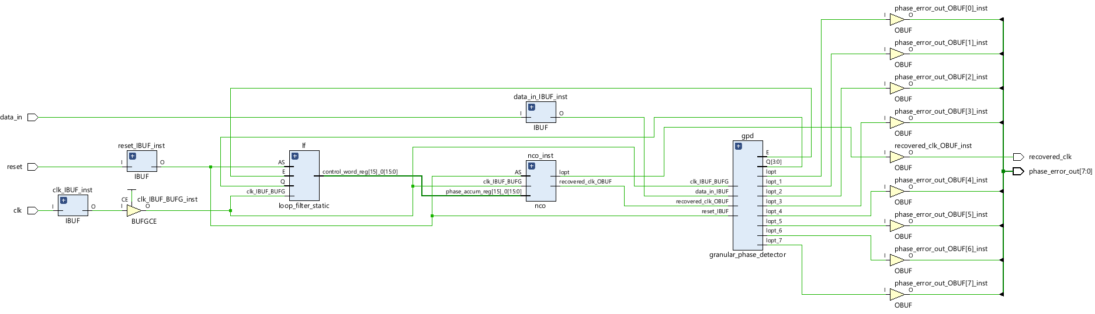
Baseline Design Architecture
Simpler architecture: Granular phase detector (GPD) + basic integrator.
No adaptive logic or DSP blocks.
Lower resource and power usage.
Sufficient for basic CDR functionality.
6
04/14/2025
Notes:
Baseline Design: The baseline design uses a Granular Phase Detector (GPD) along with a basic integrator in the loop filter. The GPD provides finer-grained error signals than a traditional Bang-Bang detector, allowing for better adjustment of the recovered clock.
No Adaptive Logic: Unlike the adaptive design, this design does not use any learning or adaptive algorithms. The loop filter is static and simply integrates the error signal to adjust the clock recovery.
Lower Resource Usage: Since there is no complex adaptive logic or reinforcement learning involved, the resource and power consumption is minimal. The baseline design is well-suited for simpler applications but may not perform as well under variable jitter conditions compared to the adaptive design.

Slide 7
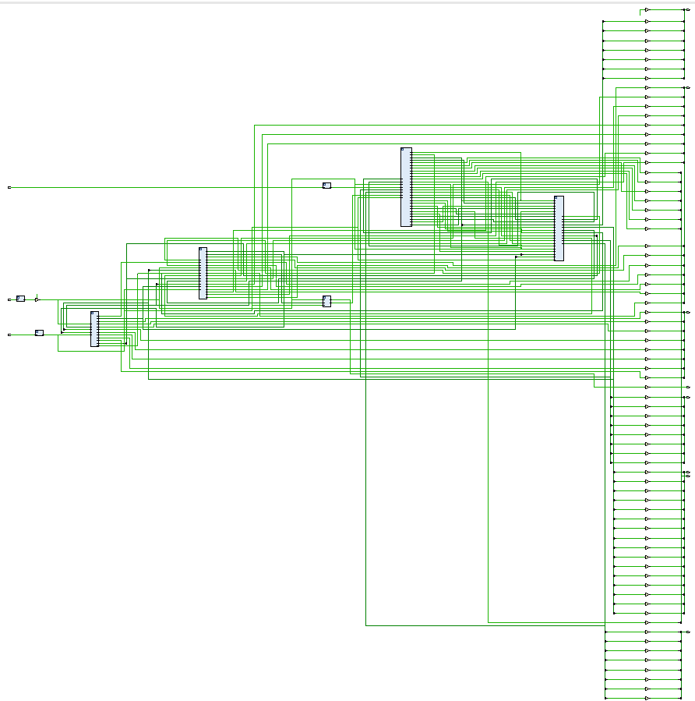
Adaptive Design Architecture
Adds adaptive loop filter logic: Reinforcement learning agent dynamically adjusts gain.
Learning Behavior: RL agent adjusts the weights based on phase error trends.
More complex feedback loop.
Uses DSP blocks for better filtering precision.
7
04/14/2025
Notes:
Granular Phase Detector: The granular phase detector is still used in the adaptive design. The output phase error is used as the feedback signal for the adaptive loop filter.
Reinforcement Learning (RL) Agent: This is the key difference in the adaptive design. The RL agent dynamically adjusts the gain in response to trends in the phase error. The agent learns from past errors and fine-tunes its parameters (w1, w2, and bias) to improve the phase locking.
Adaptive Control: The RL agent works alongside the loop filter, adjusting the filter’s gain based on the phase error and other factors, making the design more resilient to jitter and noise than the baseline design.
Use of DSP Blocks: The adaptive design utilizes DSP blocks for more precise filtering and to handle the more complex feedback loop.

Slide 8
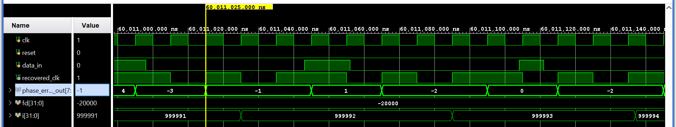
Testbench & Simulation Environment
Stimulus: Data patterns with deterministic and randomized transitions.
Jitter Injection: Gaussian noise, bounded edge shift.
Real-time observation of phase error and recovered clock.
Testbench: Measures stability, lock time, and control word behavior.
Simulation: Run over millions of cycles for statistical accuracy.
8
04/14/2025
Notes:
Stimulus Generation: The testbench generates input data (data_in) with both deterministic and randomized transitions. This allows testing the CDR under realistic conditions, with jitter and noise added to the signal.
Jitter Injection: Gaussian noise and bounded edge shifts are applied to simulate real-world transmission conditions. This ensures that both designs are tested under challenging conditions where the ability to lock to the clock is crucial.
Real-Time Observation: The phase error and recovered clock are observed during the simulation, which helps analyze the stability and lock time.
Extensive Simulation: To ensure accuracy, the simulation runs over millions of cycles, ensuring statistical significance in the results.

Slide 9
Resource & Power Comparison
Highlights:
Adaptive design uses small amount of logic and DSP resources.
Slight increase in dynamic power (~0.08 W).
Minimal hardware cost for the improvement in functionality.
Metric | Baseline CDR | Adaptive CDR
LUT Usage | 49 | 400
Flip Flops | 80 | 190
DSP Blocks | 0 | 7
I/O Pins | 12 | 76
Total Power | 0.621 W | 0.701 W
Dynamic Power | 0.007 W | 0.087 W
9
04/14/2025
Notes:
Overview: This slide compares the resource and power usage between the baseline and adaptive CDR designs, with a particular focus on the hardware requirements and power consumption.
Adaptive Design:
<1% logic and DSP resources used: This indicates that the adaptive design is highly efficient in terms of resource usage. It only uses a small fraction of the logic and DSP blocks, making it lightweight and cost-effective in terms of hardware.
Slight increase in dynamic power: The dynamic power consumption increases by about 0.08 W. While this is a minimal increase, it’s important to note that the adaptive design’s added functionality justifies this power trade-off.
Minimal hardware cost: Despite the added complexity of the adaptive functionality, the increase in hardware cost is negligible, making it a cost-effective solution for enhancing system functionality.
Key Metrics Comparison:
LUT Usage: The adaptive CDR design uses significantly more LUTs (400) compared to the baseline CDR (49). This is expected, given that the adaptive design involves more logic and computational components.
Flip Flops & DSP Blocks: There is a significant increase in the use of flip-flops (from 80 to 190) and the addition of DSP blocks (0 to 7). The adaptive design relies more on flip-flops for storing intermediate data and uses DSP blocks for specialized processing tasks.
I/O Pins: The increase in I/O pins (12 to 76) reflects the need for additional communication interfaces in the adaptive design.
Power Consumption: The total power consumption increases slightly, but the increase is minimal, which is acceptable given the added functionality and performance.

Slide 10
Timing Analysis
Highlights:
All timing constraints met in both designs.
Adaptive design: More complex (double the endpoints), yet still passes.
WNS lower due to deeper logic, expected tradeoff for advanced control.
Timing Metric | Baseline CDR | Adaptive CDR
Worst Negative Slack | 8.602ns | 1.524ns
Worst Hold Slack | 0.052ns | 0.045ns
Pulse Width Slack | 4.725ns | 4.725ns
Failing Endpoints | 0 | 0
Total Endpoints | 115 | 248
10
04/14/2025
Notes:
Overview: This slide provides a detailed comparison of timing analysis for both the baseline and adaptive CDR designs. The focus is on how the more complex adaptive design handles timing constraints despite increased complexity.
Key Observations:
All timing constraints met: Both designs satisfy their respective timing constraints, which is a critical success factor for any digital design. Despite the increase in complexity with the adaptive design, it remains stable and functional.
Adaptive Design Complexity:
The adaptive design introduces more complexity (double the endpoints), yet it still meets all timing requirements. This indicates that the design’s more advanced features (such as the adaptive control mechanism) do not compromise its performance.
The worst negative slack improves dramatically (from 8.602ns in the baseline to 1.524ns in the adaptive), demonstrating better overall timing performance in the adaptive design.
Worst Hold Slack & Pulse Width Slack: These metrics are nearly identical for both designs, indicating that both designs maintain good timing for hold and pulse width, crucial for synchronization.
WNS Lower in Adaptive Design: The worst negative slack (WNS) is lower in the adaptive design due to the more complex logic. This is expected, as deeper logic often leads to a reduction in slack, but it’s compensated for by advanced control features that maintain functionality.
Failing Endpoints: Both designs have zero failing endpoints, meaning that neither design has any setup or hold violations, ensuring stable operation.
Total Endpoints: The adaptive design has a larger number of total endpoints (248) compared to the baseline design (115). This increase is due to the added complexity and control elements in the adaptive design.

Slide 11
Performance Results
Average phase error (50ms simulation):
Baseline (Granular Phase Detector): 2.08
Adaptive (RL-based with Granular Phase Detector): 2.00 (3.8% improvement)
Phase error variance reduced, smoother response.
Faster lock-in time and less fluctuation.
Demonstrates benefit of smarter feedback control.
11
04/14/2025
Notes:
Phase Error Improvement: Over a 50ms simulation:
Baseline Design: Achieved an average phase error of 2.08.
Adaptive Design: Achieved an average phase error of 2.00, resulting in a 3.8% improvement.
The adaptive design reduced phase error slightly, showing that the reinforcement learning agent was able to dynamically adjust and improve phase locking performance under jitter.
Stability: The phase error variance is reduced in the adaptive design, showing a smoother, more stable response. This means less fluctuation in the recovered clock, improving reliability.
Faster Lock-In Time: The adaptive design not only improved phase error but also demonstrated faster convergence to the correct phase, a key advantage when locking to high-speed signals.

Slide 12
Questions?
12
04/14/2025
Notes:
Why did you choose to use a granular phase detector instead of a bang-bang detector?
A: A granular phase detector provides more resolution in detecting phase offsets, unlike bang-bang detectors which only output a binary early/late signal. This finer granularity is crucial for adaptive control since it gives the RL agent and filter more precise feedback, enabling smoother adjustments and better jitter suppression under dynamic conditions.
🔹 Q2: How does your reinforcement learning agent actually work? What does it observe and how does it learn?
A: The RL agent operates on discrete time steps, observing recent phase error magnitudes, the sign of error transitions, and loop output history. It quantizes this information into bins to reduce complexity. The reward function is based on minimizing absolute phase error, and penalties are applied for unstable oscillations or regressive behavior. Over time, it learns to select gain values that yield the lowest average phase error.
🔹 Q3: Why did you include both Kalman and PI filters? What’s the difference in behavior?
A: Kalman filtering is optimal in the presence of Gaussian noise and provides statistically smoothed estimates. The PI controller, on the other hand, is a more traditional control approach that offers faster response and simplicity. I wanted to compare both under matched jitter profiles — the Kalman filter was more stable under sustained jitter, while the PI controller locked faster but could overshoot if poorly tuned.
🔹 Q4: What was the most difficult part of the project?
A: Integrating the RL agent in a way that didn’t break timing or consume excessive logic was the hardest. Designing a reward function that encouraged learning without instability was also tricky — it took iterations to get a useful policy that adapted consistently across different jitter profiles.
🔹 Q5: Why does your design have such low resource usage? Does that mean it’s a simple design?
A: Not necessarily — the low resource usage reflects efficient design, not a lack of complexity. The architecture is modular, and the control logic is optimized. Despite the design's adaptability, it only uses 0.17% of LUTs and less than 1% of DSPs, which shows that smart design choices can yield high functionality with minimal hardware cost.
🔹 Q6: How would your design behave in a real hardware system with varying data rates?
A: The design is parameterized and can support different clock rates by retargeting in Vivado. Because of the adaptive filter and RL loop, it can handle fluctuations in timing margin more gracefully than static designs. For extreme cases, the filter coefficients or RL state space would need to be re-optimized.
🔹 Q7: How does this compare to a hardware PLL? Could this replace an analog CDR in industry?
A: Not directly. Analog PLLs offer very high-speed performance with low jitter for SerDes and RF applications. However, for mid-speed or all-digital systems, like in some FPGAs or software-defined radios, a digital CDR like this is more flexible, portable, and scalable. It’s especially appealing for low-power or reconfigurable systems.
🔹 Q8: What would you improve or do next?
A: I’d add support for partial reconfiguration or multiple operating modes — for instance, switching between low-power and high-performance modes. I’d also explore on-chip training of the RL agent with a larger observation space and extend the design to support multi-lane recovery for systems like PCIe Gen4 or 100G Ethernet.
Q: What kind of reinforcement learning did you implement?
A: A lightweight, table-based Q-learning approach. I quantized the environment into discrete states based on phase error behavior and loop response. For each state, the agent learns the best action — whether to increase, decrease, or hold the loop gain — based on rewards tied to phase error suppression.
🔹 Q: Why did you use RL instead of tuning gains manually?
A: Manual tuning only works well for one noise profile. RL lets the CDR adapt to dynamic conditions in real time, like bursty jitter or variable delay. The agent self-adjusts based on observed error behavior, avoiding over- or under-correction without needing human intervention.
🔹 Q: How is the reward function defined?
A: The agent receives higher reward when the average absolute phase error decreases after an action. It’s penalized if error increases or if control changes lead to oscillations. This encourages stability and smooth convergence.
🔹 Q: What is the state space and action space size?
A: The state space is small and discrete — phase error magnitude is bucketed (e.g., low/med/high), recent sign flips are binary, and prior action memory is tracked. The action space is 3: increase, decrease, or maintain gain. This makes the policy compact and feasible for real-time FPGA operation.
🔹 Q: How does the RL agent avoid instability or overcorrecting?
A: The reward function penalizes aggressive moves that result in error fluctuation or divergence. Over time, the policy favors stable gain choices that result in consistently lower error — effectively dampening the loop response in noisy conditions.
🔹 Q: How is this implemented in hardware?
A: The agent runs as a simple finite state machine (FSM) or lookup logic that updates internal registers based on error input. It’s not a full neural network — it’s efficient enough for RTL synthesis and fits comfortably within <1% logic usage.

